Slide 1
IEEE Volunteering and Reporting Tools
Mallellu Sai Prashanth
Webinar ad Training Coordinator, IEEE R10 Student Activities Committee
Collabratec Coordinator, IEEE R10 SAC

Slide 2
Overview of “MyIEEE”

Slide 3
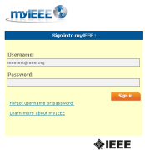
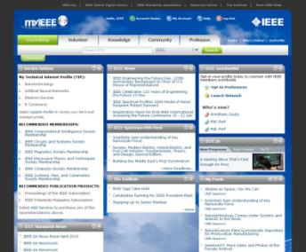
myIEEE
Why?
Saves you time to find resources
IEEE information personalized to your technical, demographic, and geographic interests
To do…
Visit www.ieee.org/myieee, and log-in using your IEEE Account
Familiarize yourself with myIEEE’s navigation and features
Customize your myDesktop with a selection of any myIEEE modules/gadgets
Locate link to ‘myAccount’ in navigation header area
Notes:
Knowledge
All IEEE members receive the award-winning IEEE Spectrum magazine - and exclusive access to IEEE Spectrum Online - plus online access to IEEE Potentials magazine. IEEE members have online access to the tables of contents and expanded abstracts from more than one million IEEE documents, along with full-text searching of the entire IEEE collection. IEEE members also receive exclusive member subscriptions rates on the journals, and discounts on the purchase of conference proceedings, standards, and books.
Community
No matter where you live, IEEE is there, with more than 300 local IEEE sections, 1,300 technical chapters, and 300 annual IEEE conferences worldwide. As a member, you'll have the opportunity to attend your local section or chapter meetings, volunteer for leadership positions, or attend a conference to meet industry leaders and practitioners, encounter the latest research, and present your papers to an international audience.
Profession
IEEE career and employment resources offer great opportunities for IEEE members. Whether you are a job seeker, consultant or entrepreneur, the IEEE Job Site, Consultants Database, and career publications offer you the edge you need to succeed. IEEE also offers technical and professional online courses from the top universities and corporate educational institutions at exclusive discounts for IEEE members.

Slide 4
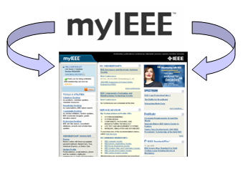
Bringing it all together… myIEEE™
myIEEE is a one-stop, personalized web portal providing IEEE members with convenient access to IEEE’s web based member benefits and account information.
Connect with your local IEEE Section
Desktop navigation w/personalized benefit access
Society memberships and conference updates
Latest news from IEEE Spectrum, IEEE Standards, and The institute Direct and seamless access into membership account
Addition of online membership directory in 4Q-2006
Notes:
Learn more about myIEEE - http://www.ieee.org/portal/web/membership/IEEEtv/about.html
IEEE.tv is an Internet broadcasting network made possible by the members of IEEE.
IEEE.tv produces and delivers special-interest programming about technology and engineering, and is available in two versions:
IEEE.tv Member/Basic - Programming that is an exclusive benefit of IEEE membership, offering more technically-advanced topics impacting industry and the engineering community.
IEEE.tv Public Access - Programs that are free to the general public, offering information and guidance about careers in technology and engineering, topics of public interest, and introductions to new IEEE products.
IEEE.tv can be launched from http://www.ieee.org/portal/web/membership/IEEEtv/about.html, and is also accessible from myIEEE, the members-only portal.
Featured Programs - http://www.ieee.org/portal/web/membership/IEEEtv/about.html

Slide 5
Students can Experience
IEEE Xplore
IEEE Student Job Site
Humanitarian Programs
IEEE Member Digital Access
Association with IEEE Brand
Today’s Engineer
Travel Services
Merchandise
IEEE-USA EBooks
Microsoft Software for Students
^{myIEEE} IEEE MemberNet
IEEE Contact Center
Insurance Services _{Upgrade Membership}
IEEE Standards
IEEE Societies
eBook Classics
Scholarships
Member Discounts
Local Meetings
IEEE Women in Engineering
IEEE Potentials
Online Communities
IEEE Conferences
ShopIEEE
The Institute
IEEE Spectrum
LinkedIn Group
_{Membership Card}Public Policy Awareness Employment Navigator
IEEE.tv
Volunteering
IEEE Email Alias

Slide 6
SB Hierarchy

Slide 7
Officer Reporting

Slide 8
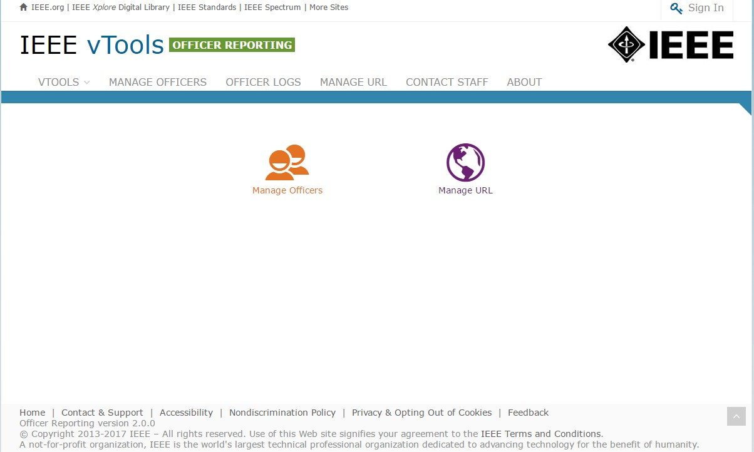
Sign in
Select “Manage Officers” to view and report officers for an organizational unit.
You must be signed in to report officers or manage a URL.
Select “Manage Officers” to view and report officers of an organizational unit.

Slide 9
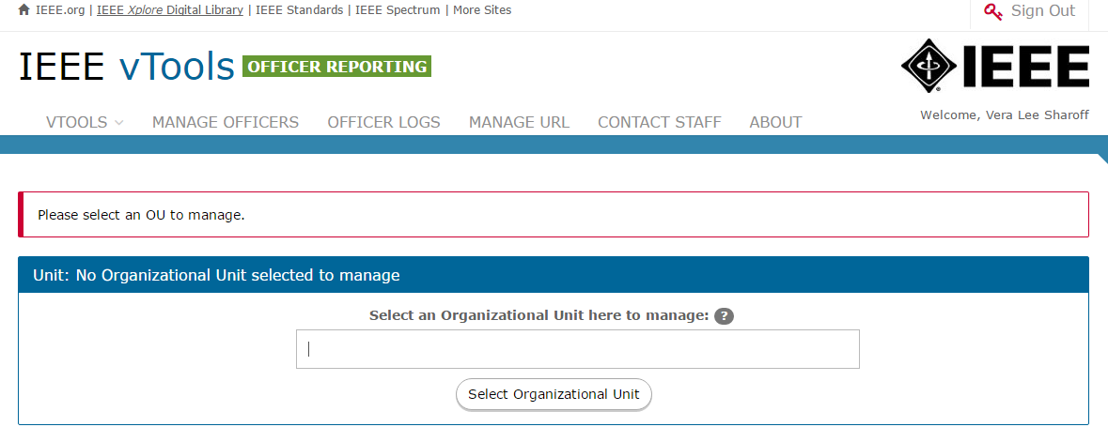
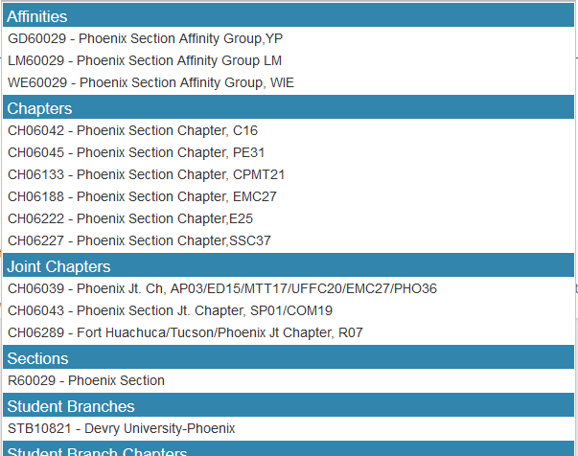
Select Organizational Unit
Enter name/SPO ID or Geocode
of organizational unit in text box.
A list of matches will be shown.
Click on name in list to select organizational unit and retrieve officer roster and URL.

Slide 10
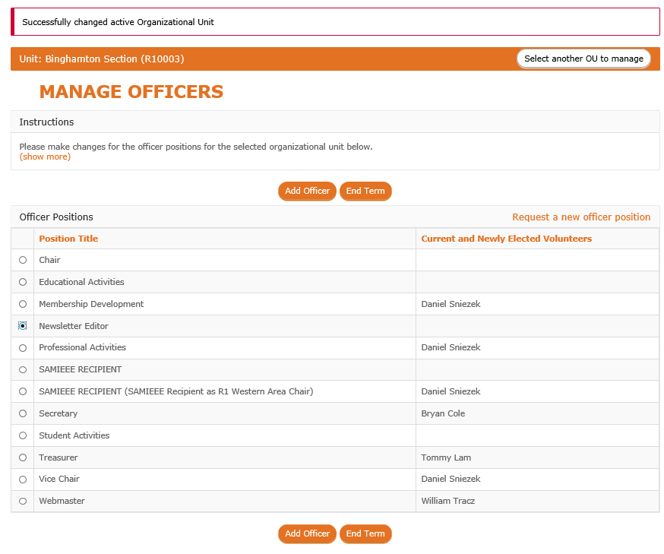
Manage Officers - Organizational Unit roster
MANAGE OFFICERS
– Allows you to view officers, add a new officer and end term of an individual officers for a selected position in the organizational unit selected.
Select Position and click on “Add Officer” to add a new officer to selected position.

Slide 11
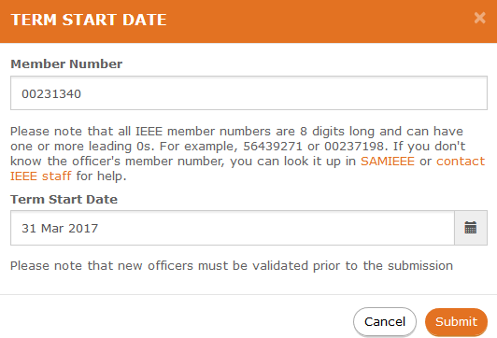
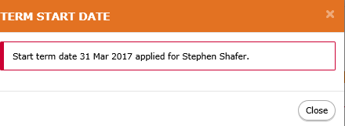
Add Officer number and term date
Enter member number and
Term Start Date.
Click on “Submit” to validate.
The system will retrieve member data and validate that (s)he is eligible to serve in the position based on IEEE rules.
Confirmation.

Slide 12
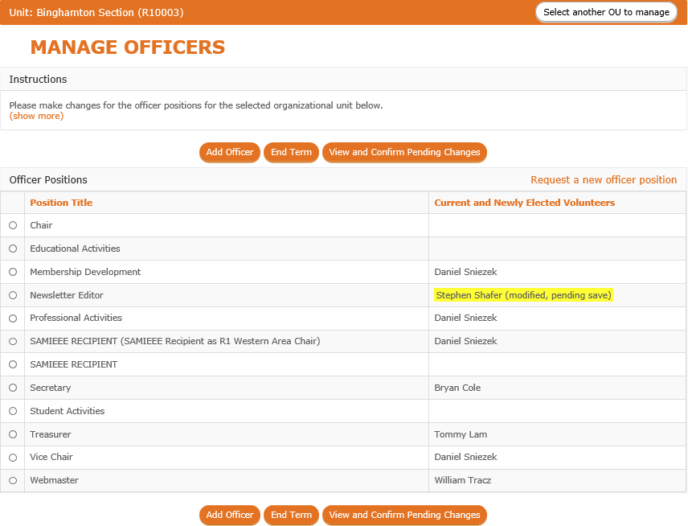
Manage Officers -
Pending changes for a position
Select “View and Confirm Pending Changes” to review and submit changes.
Note multiple changes can be made before clicking on "View and Confirm Pending Changes".
Officer name is now highlighted to show changes are pending.
Note – tooltip includes details of change.

Slide 13
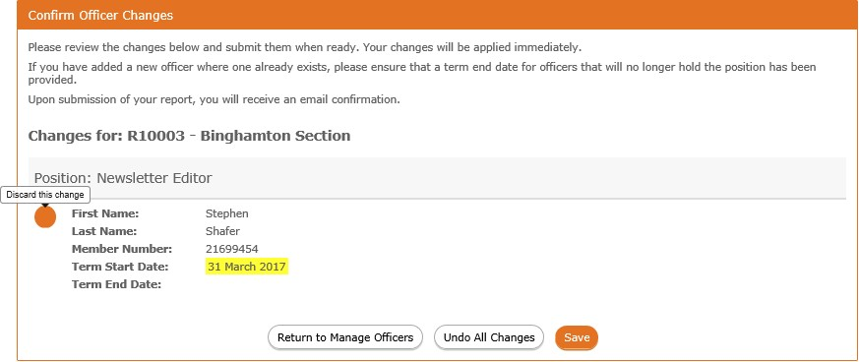
Manage Officers - Confirm Officer Changes
If you are an officer of the organizational unit in which this report is for, your changes will be made immediately. Otherwise, changes will be reviewed by staff before taking effect.
A list of changes will be shown.
Click “Save” to confirm all changes.
Click “Undo All Changes” to discard all pending changes.

Slide 14
Manage Officers - Confirmation of report

Slide 15
Publish an Event through Vtools

Slide 16
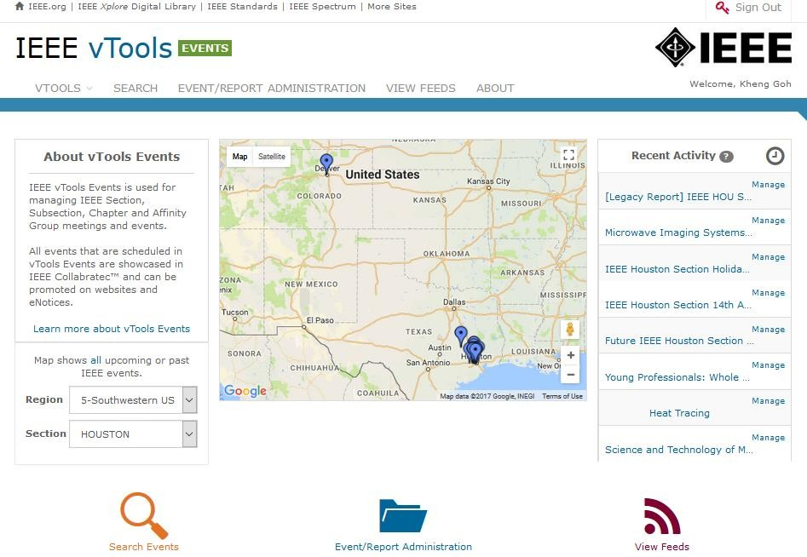
Publish An Event
You must be signed in to create/edit an event.
Select “Event/Report Administration” to access volunteer options – Schedule a New Event
Click on the “Event/Report Administration” icon.
3

Slide 17
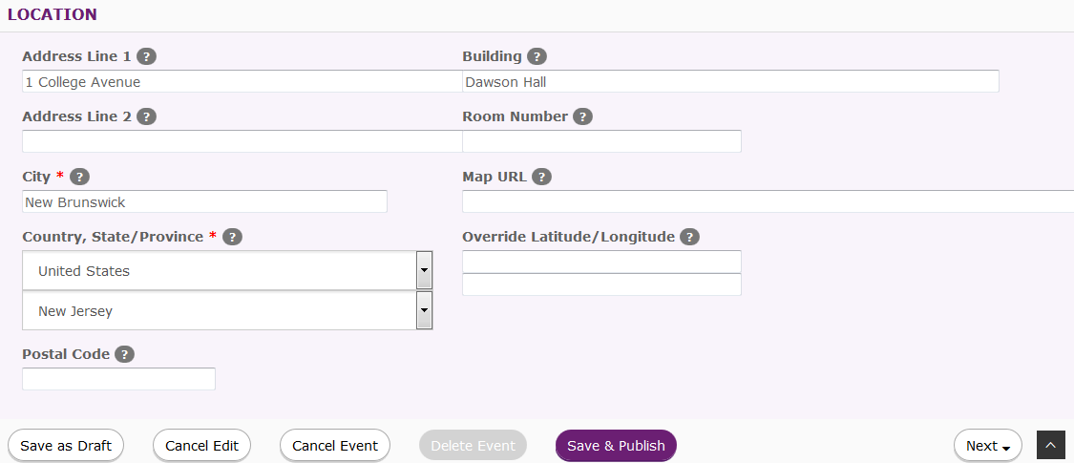
Edit Event – Save & Publish
Edit a draft event and publish it by clicking ‘Save & Publish’
4
Click on “Save & Publish” to save and publish the event.

Slide 18
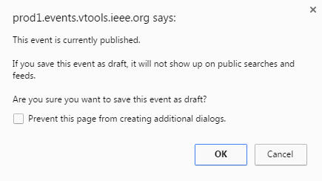
Save Published Event as Draft
Save published event as a draft event.
5
Click on “Save as Draft” to save the event as draft.

Slide 19
File a Report for an Existing Event – Recent Events tab

Slide 20
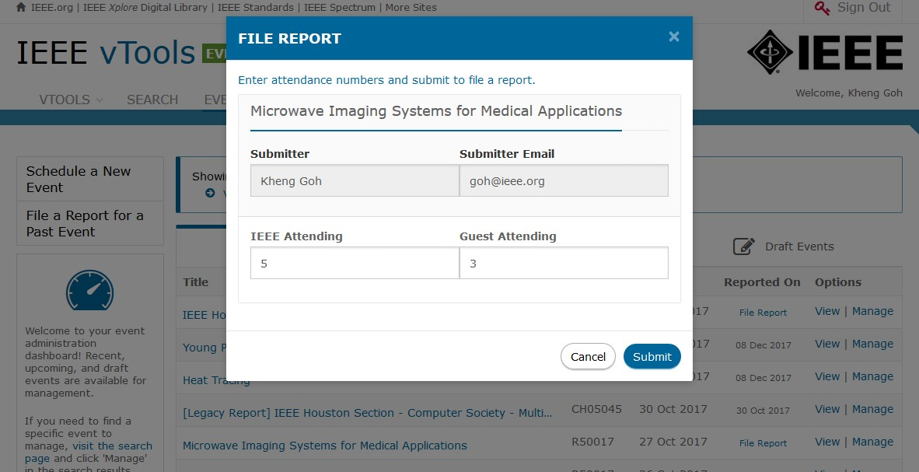
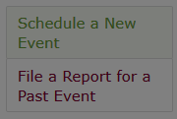
Recent event - File Report option
Enter
attendance
Click on “File Report” to open report.
3

Slide 21
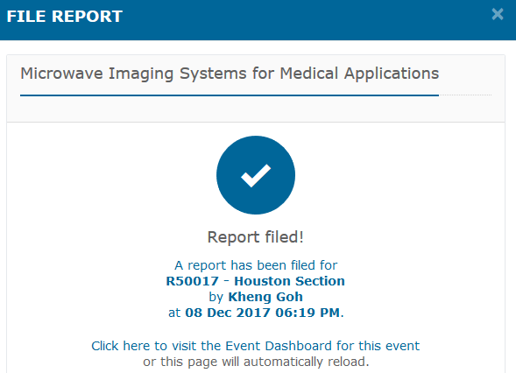
Recent Event – File Report
Note - you may edit the event and report up to 7 days from the
submission date.
4
If you need help, send email to l31-help@ieee.org for assistance.

Slide 22
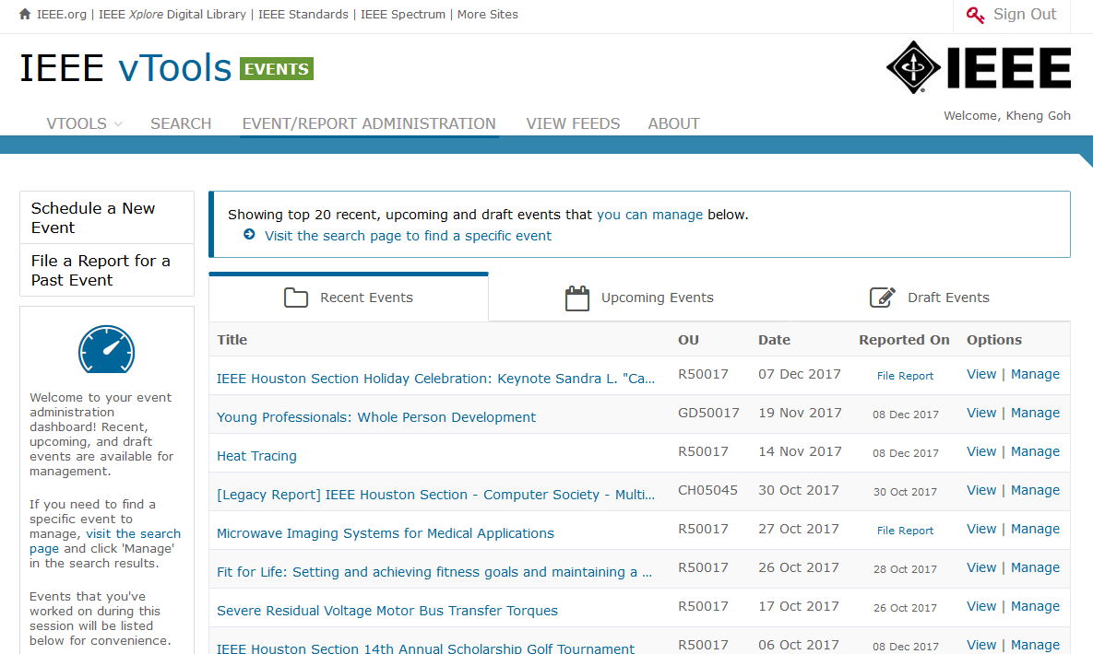
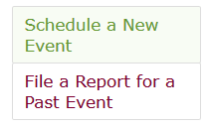
Recent Events - Report Information
You must be signed in to file a report.
The Reported On option “File Report” opens report (L31).
Date indicates when a report has been submitted.
5

Slide 23
Student Branch Annual Plan Reporting

Slide 24
Sign In
You must be signed in to access volunteer options - create a new annual plan.

Slide 25
Student Branch Annual Plan
Select “New Plan” to open new plan form.
Click on ‘Submitted Plans’ to
view and download PDF version.
Click on ‘Saved Plans’ to edited plans that have been saved and not submitted.

Slide 26
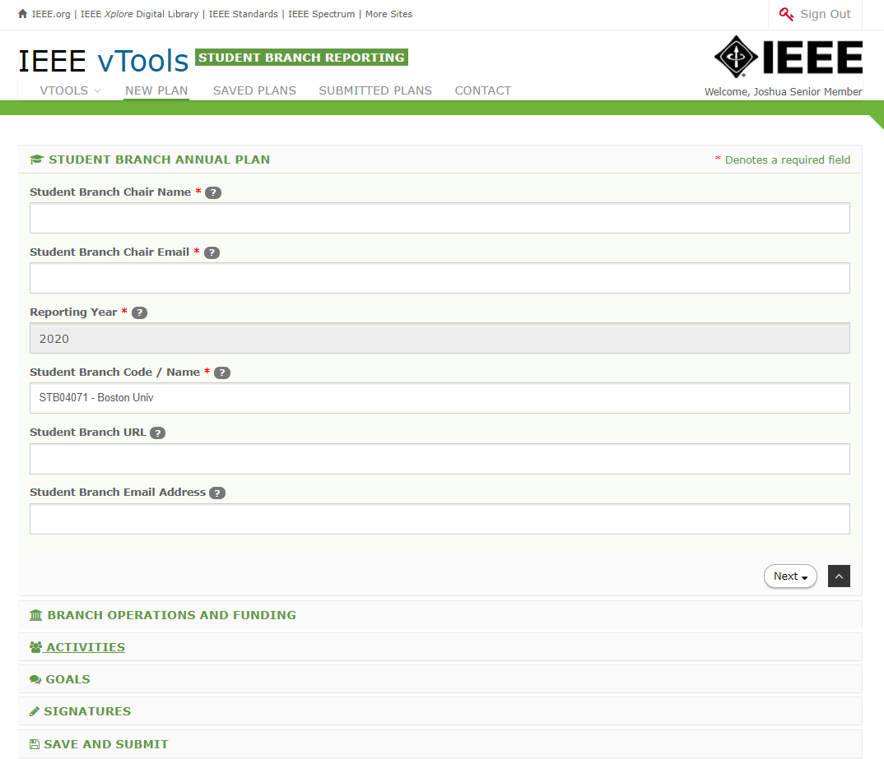
New Annual Plan
Note: Fields marked with an asterisk (*) are required.
For additional help, hover cursor over question mark (‘?’) for hints.

Slide 27
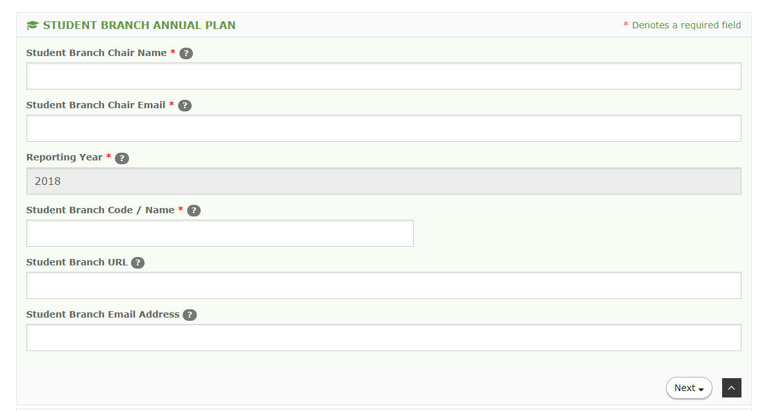
Student Branch Code / Name
Note: Fields marked with an asterisk (*) are required.
Student Branch Annual Plan –
Reporting Year is be read only.
Student Branch Code / Name –
Value displayed will be based on volunteer signed in.
For additional help, hover cursor over question mark (‘?’) for hints.

Slide 28
Saved Plans
Click on “Schedule a New Event” to open event form.

Slide 29
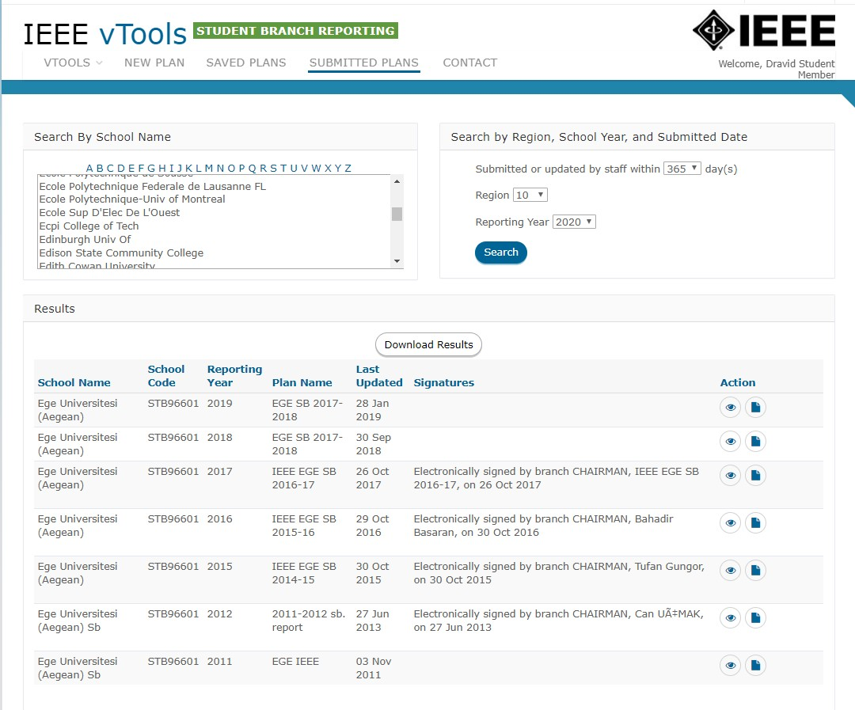
Submitted Plans (Search by Name, Reporting Year and download PDF)

Slide 30
IEEE Collabratec

Slide 31
IEEE Collabratec
IEEE Collabratec builds upon those features and offers more ways to access information and people.
Distinct professional identity, through your professional profile and IEEE Member badging
Access the IEEE Member Directory, a listing of over 250,000 members
Member-only searching criteria: Discover other members in your local Section/Region
Participate in IEEE Mentoring program
Access to members-only communities and IEEE-sponsored communities on hot topics
Take advantage of groups by creating more groups with a larger number of participants per group
Personalized certificate of IEEE membership available for PDF download and display, refreshed annually

Slide 32
Key Elements
Umbrella Message: integrated experience, new tool, digital connection, collaboration, community, creation, tools to aid publishing, global engineering/technology focus, distinguished, one suite/hub
Members: networking, connecting, career development, assist production, new opportunities, one suite/hub
Volunteers: easier process to connect, get things done, engagement, one suite/hub
Authors/Researchers: easier workplace, time saver, assist productivity, collaboration, connection, one suite/hub
Institutional Customers / academia: added value; collaboration, global, connection, teams without boundaries, time saver, assist productivity, easier workplace, one suite/hub
Institutional Customers / corporate: proprietary communities; multi-faceted collaboration, teams without boundaries, free tools, time saver, assist productivity, one suite/hub
Technical Activities: community builder; build and manage professional network, knowledge sharing, technically current, one suite/hub

Slide 33
IEEE Resume Labs

Slide 34
Resumes
Letters
Portfolio
Assessments
Mock Interviews
Video Resumes

Slide 35
ResumeLab Continued..
Prepare for your future employment using IEEE ResumeLab:
Visit www.ieee.org/resumelab.
Sign in using your IEEE Web Account.
Create your IEEE ResumeLab profile. The information you enter into
IEEE ResumeLab can be different from that used on IEEE.org.
To allow better customization of your resume and other resources, it
will not be connected to your member record.
Begin exploring the benefits of IEEE ResumeLab!
NOTE:
ResumeLab is available to IEEE members of any grade at no additional cost.
Some features require a computer webcam and high-speed internet connection.

Slide 36
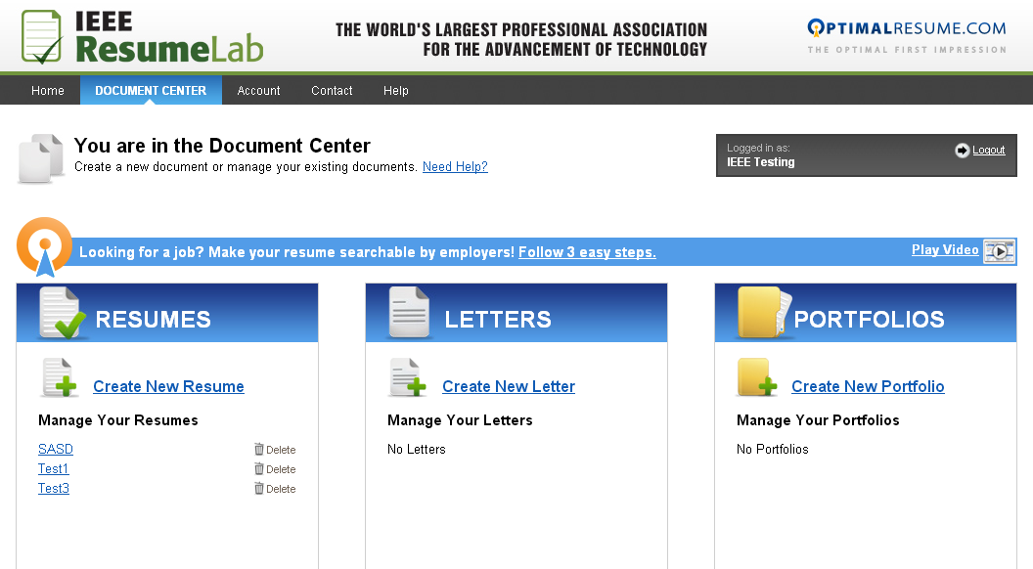
Document Center
Log in with your IEEE.org username/password
Complete profile

Slide 37
Stay current with the IEEE…
Officer Reporting: https://officers.vtools.ieee.org/
Activity Reporting: https://sbr.vtools.ieee.org/
Student Benefits: www.ieee.org/students
Webinar trainings: http://bit.ly/ieeewebinars
Meeting submission L31 : https://meetings.vtools.ieee.org/main

Slide 38
Contact IEEE Student Services…
Global Student Facebook Page:
https://www.facebook.com/IEEEStudents?ref=hl
Website: IEEE Students:
www.ieee.org/students
E-mail: student-services@ieee.org
Twitter: www.twitter.com/IEEE_Students

Slide 39
Patience Appreciate Recognition Reward Award

Slide 41
saiprashanth08@ieee.org

